Slide 1

Lecture 6: TAU Performance System
Allen D. Malony
Department of Computer and Information Science

Slide 2
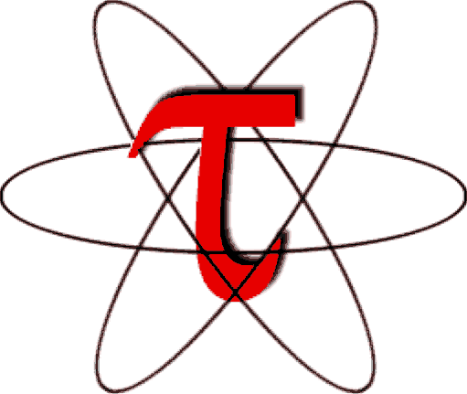
TAU Performance System®
Tuning and Analysis Utilities (20+ year project)
Performance problem solving framework for HPC
Integrated, scalable, flexible, portable
Target all parallel programming / execution paradigms
Integrated performance toolkit
Multi-level performance instrumentation
Flexible and configurable performance measurement
Widely-ported performance profiling / tracing system
Performance data management and data mining
Open source (BSD-style license)
Broad use in complex software, systems, applications
http://tau.uoregon.edu

Slide 3
TAU History
1992-1995: Malony and Mohr work with Gannon on DARPA pC++ project work. TAU is born. [parallel profiling, tracing, performance extrapolation]
1995-1998: Shende works on Ph.D. research on performance mapping. TAU v1.0 released. [multiple languages, source analysis, automatic instrumentation]
1998-2001: Significant effort in Fortran analysis and instrumentation, work with Mohr on POMP, Kojak tracing integration, focus on automated performance analysis. [performance diagnosis, source analysis, instrumentation]
2002-2005: Focus on profiling analysis tools, measurement scalability, and perturbation compensation. [analysis, scalability, perturbation analysis, applications]
2005-2007: More emphasis on tool integration, usability, and data presentation. TAU v2.0 released. [performance visualization, binary instrumentation, integration, performance diagnosis and modeling]
2008-2011: Add performance database support, data mining, and rule-based analysis. Develop measurement/analysis for heterogeneous systems. Core measurement infrastructure integration (Score-P). [database, data mining, expert system, heterogeneous measurement, infrastructure integration]
2012-present: Focus on exascale systems. Improve scalability. Add hybrid measurement support, extend heterogeneous and mixed-mode, develop user-level threading. Apply to petascale / exascale applications. [scale, autotuning, user-level]

Slide 4
General Target Computation Model in TAU
Node: physically distinct shared memory machine
Message passing node interconnection network
Context: distinct virtual memory space within node
Thread: execution threads (user/system) in context
Interconnection Network
Inter-node message communication
*
*
Node
Node
Node
physical view
memory
node memory
SMP
memory
VM
space
…
model view
…
Context
Threads

Slide 5
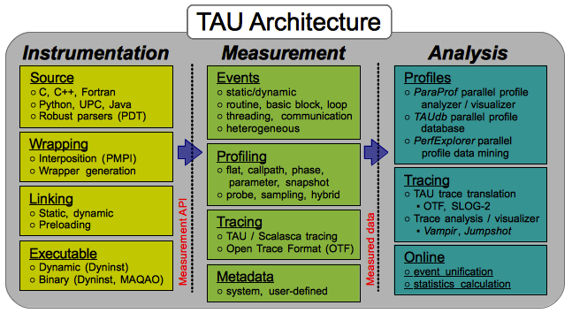
TAU Architecture
TAU is a parallel performance framework and toolkit
Software architecture provides separation of concerns
Instrumentation | Measurement | Analysis

Slide 6
TAU Observation Methodology and Workflow
TAU’s (primary) methodology for parallel performance observation is based on the insertion of measurement probes into application, library, and runtime system
Code is instrumented to make visible certain events
Performance measurements occur when events are triggered
Known as probe-based (direct) measurement
Performance experimentation workflow
Instrument application and other code components
Link / load TAU measurement library
Execute program to gather performance data
Analysis performance data with respect to events
Analyze multiple performance experiments
Extended TAU’s methodology and workflow to support sampling-based techniques

Slide 7
TAU Components
Instrumentation
Fortran, C, C++, OpenMP, Python, Java, UPC, Chapel
Source, compiler, library wrapping, binary rewriting
Automatic instrumentation
Measurement
Internode: MPI, OpenSHMEM, ARMCI, PGAS, DMAPP
Intranode: Pthreads, OpenMP, hybrid, …
Heterogeneous: GPU, MIC, CUDA, OpenCL, OpenACC, …
Performance data (timing, counters) and metadata
Parallel profiling and tracing (with Score-P integration)
Analysis
Parallel profile analysis and visualization (ParaProf)
Performance data mining / machine learning (PerfExplorer)
Performance database technology (TAUdb)
Empirical autotuning

Slide 8
TAU Instrumentation Approach
Direct and indirect performance instrumentation
Direct instrumentation of program (system) code (probes)
Indirect support via sampling or interrupts
Support for standard program code events
Routines, classes and templates
Statement-level blocks, loops
Interval events (start/stop)
Support for user-defined events
Interval events specified by user
Atomic events (statistical measurement at a single point)
Context events (atomic events with calling path context)
Provides static events and dynamic events
Instrumentation optimization

Slide 9
TAU Instrumentation Mechanisms
Source code
Manual (TAU API, TAU component API)
Automatic (robust)
C, C++, F77/90/95, OpenMP (POMP/OPARI), UPC
Compiler (GNU, IBM, NAG, Intel, PGI, Pathscale, Cray, …)
Object code (library-level)
Statically- and dynamically-linked wrapper libraries
MPI, I/O, memory, …
Powerful library wrapping of external libraries without source
Executable code / runtime
Runtime preloading and interception of library calls
Binary instrumentation (Dyninst, MAQAO, PEBIL)
Dynamic instrumentation (Dyninst)
OpenMP (runtime API, CollectorAPI, GOMP, OMPT)
Virtual machine, interpreter, and OS instrumentation

Slide 10
Instrumentation for Wrapping External Libraries
Preprocessor substitution
Header redefines a routine with macros (only C and C++)
Tool-defined header file with same name takes precedence
Original routine substituted by preprocessor callsite
Preloading a library at runtime
Library preloaded in the address space of executing application intercepts calls from a given library
Tool wrapper library defines routine, gets address of global symbol (dlsym), internally calls measured routine
Linker-based substitution
Wrapper library defines wrapper interface
wrapper interface then which calls routine
Linker is passed option to substitute all references from applications object code with tool wrappers

Slide 11
Automatic Source-level / Wrapper Instrumentation
PDT source analyzer
Application
source
Parsed program
tau_instrumentor
Instrumented
source
Instrumentation
specification file
tau_wrap
BEGIN_FILE_EXCLUDE_LIST
f*.f90
Foo?.cpp
END_FILE_EXCLUDE_LIST
BEGIN_FILE_INCLUDE_LIST
main.cpp
foo.f90
END_FILE_INCLUDE_LIST
BEGIN_EXCLUDE_LIST
Foo
Bar
D#EMM
END_EXCLUDE_LIST

Slide 12
MPI Wrapper Interposition Library
Uses standard MPI Profiling Interface
Provides name shifted interface (weak bindings)
MPI_Send = PMPI_Send
Create TAU instrumented MPI library
Interpose between MPI and TAU
-lmpi replaced by –lTauMpi –lpmpi –lmpi
No change to the source code, just re-link application!
Can we interpose MPI for compiled applications?
Avoid re-compilation or re-linking
Requires shared library MPI
uses LD_PRELOAD for Linux
Approach will work with other shared libraries (see later slide)
Use TAU tau_exec (see later slide)
% mpirun -np 4 tau_exec a.out

Slide 13
Binary Instrumentation
TAU has been a long-time user of DyninstAPI
Using DyninstAPI’s binary re-writing capabilities, created a binary re-writer tool for TAU (tau_run)
Supports TAU's performance instrumentation
Works with TAU instrumentation selection
files and routines based on exclude/include lists
TAU’s measurement library (DSO) is loaded by tau_run
Runtime (pre-execution) and binary re-writing supported
Simplifies code instrumentation and usage greatly!
% tau_run a.out –o a.inst
% mpirun –np 4 ./a.inst
Support PEBIL and MAQAO binary instrumentation

Slide 14
Library Interposition
Simplify TAU usage to assess performance properties
Application, I/O, memory, communication
Designed a new tool that leverages runtime instrumentation by pre-loading measurement libraries
Works on dynamic executables (default under Linux)
Substitutes routines (e.g., I/O, MPI, memory allocation/deallocation) with instrumented calls
Interval events (e.g., time spent in write())
Atomic events (e.g., how much memory was allocated)

Slide 15
TAU Execution Command – tau_exec
Uninstrumented execution
% mpirun –np 256 ./a.out
Track MPI performance
% mpirun –np 256 tau_exec ./a.out
Track I/O and MPI performance (MPI default)
% mpirun –np 256 tau_exec –io ./a.out
Track memory operations
% setenv TAU_TRACK_MEMORY_LEAKS 1
% mpirun –np 256 tau_exec –memory ./a.out
Track I/O performance and memory operations
% mpirun –np 256 tau_exec –io –memory ./a.out

Slide 16
POSIX I/O Calls Supported
Unbuffered I/O
open, open64, close, read, write, readv, writev, creat, creat64
Buffered I/O
fopen, fopen64, fdopen, freopen, fclose
fprintf, fscanf, fwrite, fread
Communication
socket, pipe, socketpair, bind, accept, connect
recv, send, sendto, recvfrom, pclose
Control
fcntl, rewind, lseek, lseek64, fseek, dup, dup2, mkstep, tmpfile
Asynchronous I/O
aio_{read,write,suspend,cancel,return}, lio_listio

Slide 17
Library wrapping – tau_gen_wrapper
How to instrument an external library without source?
Source may not be available
Library may be too cumbersome to build (with instrumentation)
Build a library wrapper tools
Used PDT to parse header files
Generate new header files with instrumentation files
Three methods: runtime preloading, linking, redirecting headers
Add to TAU_OPTIONS environment variable:
–optTauWrapFile=<wrapperdir>/link_options.tau
Wrapped library
Redirects references at routine callsite to a wrapper call
Wrapper internally calls the original
Wrapper has TAU measurement code

Slide 18
HDF5 Library Wrapping
[sameer@zorak]$ tau_gen_wrapper hdf5.h /usr/lib/libhdf5.a -f select.tau
Usage : tau_gen_wrapper <header> <library> [-r|-d|-w (default)] [-g groupname] [-i headerfile] [-c|-c++|-fortran] [-f <instr_req_file> ]
instruments using runtime preloading (-r), or -Wl,-wrap linker (-w), redirection of header file to redefine the wrapped routine (-d)
instrumentation specification file (select.tau)
group (hdf5)
tau_exec loads libhdf5_wrap.so shared library using –loadlib=<libwrap_pkg.so>
creates the wrapper/ directory with -opt
NODE 0;CONTEXT 0;THREAD 0:
---------------------------------------------------------------------------------------
%Time Exclusive Inclusive #Call #Subrs Inclusive Name
msec total msec usec/call
---------------------------------------------------------------------------------------
100.0 0.057 1 1 13 1236 .TAU Application
70.8 0.875 0.875 1 0 875 hid_t H5Fcreate()
9.7 0.12 0.12 1 0 120 herr_t H5Fclose()
6.0 0.074 0.074 1 0 74 hid_t H5Dcreate()
3.1 0.038 0.038 1 0 38 herr_t H5Dwrite()
2.6 0.032 0.032 1 0 32 herr_t H5Dclose()
2.1 0.026 0.026 1 0 26 herr_t H5check_version()
0.6 0.008 0.008 1 0 8 hid_t H5Screate_simple()
0.2 0.002 0.002 1 0 2 herr_t H5Tset_order()
0.2 0.002 0.002 1 0 2 hid_t H5Tcopy()
0.1 0.001 0.001 1 0 1 herr_t H5Sclose()
0.1 0.001 0.001 2 0 0 herr_t H5open()

Slide 19
TAU Measurement Approach
Portable and scalable parallel profiling solution
Multiple profiling types and options
Event selection and control (enabling/disabling, throttling)
Online profile access and sampling
Online performance profile overhead compensation
Portable and scalable parallel tracing solution
Trace translation to OTF, EPILOG, Paraver, and SLOG2
Trace streams (OTF) and hierarchical trace merging
Robust timing and hardware performance support
Multiple counters (hardware, user-defined, system)
Metadata (hardware/system, application, …)

Slide 20
TAU Measurement Mechanisms
Parallel profiling
Function-level, block-level, statement-level
Supports user-defined events and mapping events
Support for flat, callgraph/callpath, phase profiling
Support for parameter and context profiling
Support for tracking I/O and memory (library wrappers)
Parallel profile stored (dumped, shapshot) during execution
Tracing
All profile-level events
Inter-process communication events
Inclusion of multiple counter data in traced events

Slide 21
Parallel Performance Profiling
Flat profiles
Metric (e.g., time) spent in an event (callgraph nodes)
Exclusive/inclusive, # of calls, child calls
Callpath profiles (Calldepth profiles)
Time spent along a calling path (edges in callgraph)
“main=> f1 => f2 => MPI_Send” (event name)
TAU_CALLPATH_DEPTH environment variable
Phase profiles
Flat profiles under a phase (nested phases are allowed)
Default “main” phase
Supports static or dynamic (per-iteration) phases
Parameter and context profiling

Slide 22
Performance Analysis
Analysis of parallel profile and trace measurement
Parallel profile analysis (ParaProf)
Java-based analysis and visualization tool
Support for large-scale parallel profiles
Performance data management (TAUdb)
Performance data mining (PerfExplorer)
Parallel trace analysis
Translation to VTF (V3.0), EPILOG, OTF formats
Integration with Vampir / Vampir Server (TU Dresden)
Integration with CUBE browser (Scalasca, UTK / FZJ)
Scalable runtime fault isolation with callstack debugging
Efficient parallel runtime bounds checking

Slide 23
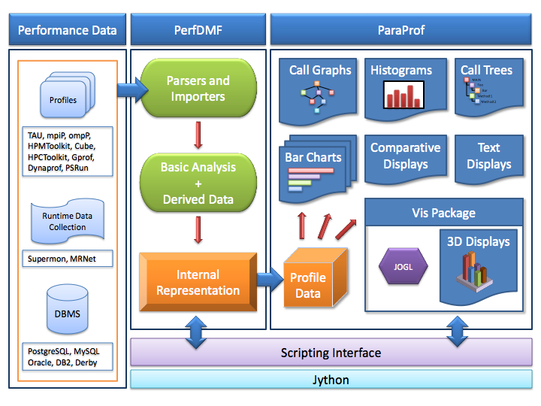
Profile Analysis Framework

Slide 24
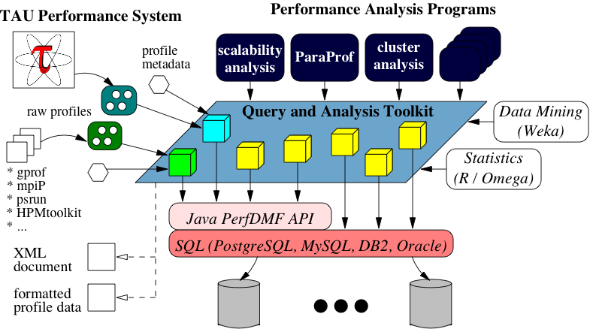
Performance Data Management (TAUdb)
Provide an open, flexible framework to support common data management tasks
Foster multi-experiment performance evaluation
Extensible toolkit to promote integration and reuse across available performance tools
Supported multiple profile formats: TAU, CUBE, gprof, mpiP, psrun, …
Supported DBMS: PostgreSQL, MySQL, Oracle, DB2, Derby, H2

Slide 25
TAUdb Database Schema
Parallel performance profiles
Timer and counter measurements with 5 dimensions
Physical location: process / thread
Static code location: function / loop / block / line
Dynamic location: current callpath and context (parameters)
Time context: iteration / snapshot / phase
Metric: time, HW counters, derived values
Measurement metadata
Properties of the experiment
Anything from name:value pairs to nested, structured data
Single value for whole experiment or full context (tuple of thread, timer, iteration, timestamp)

Slide 26
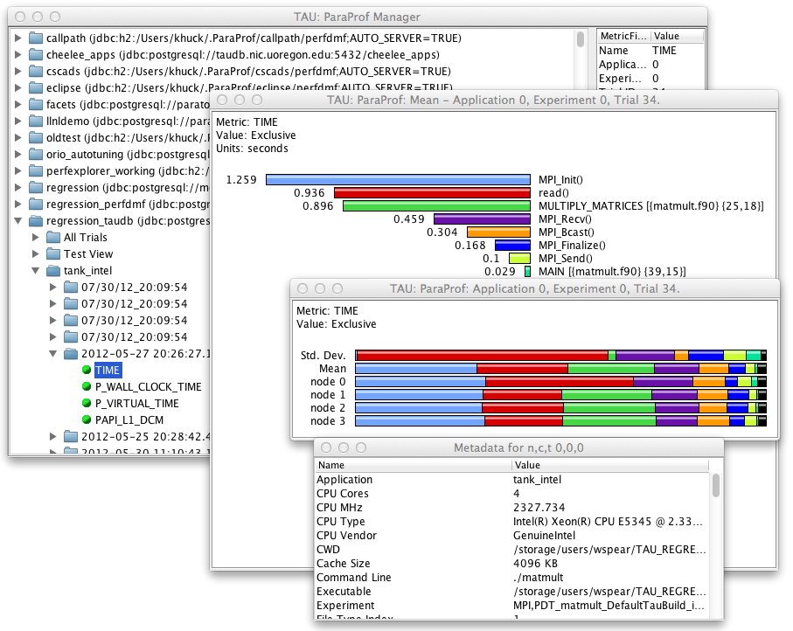
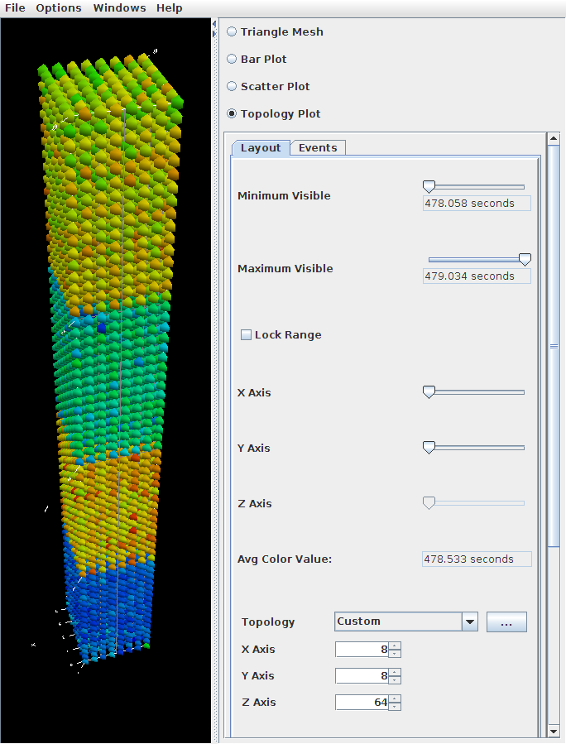
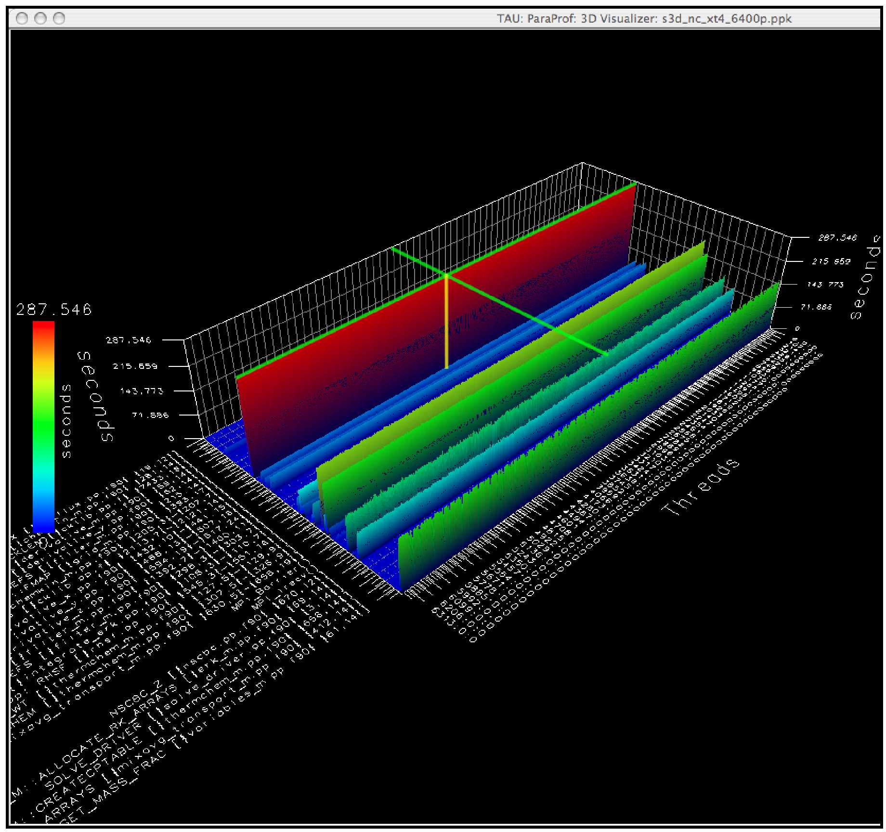
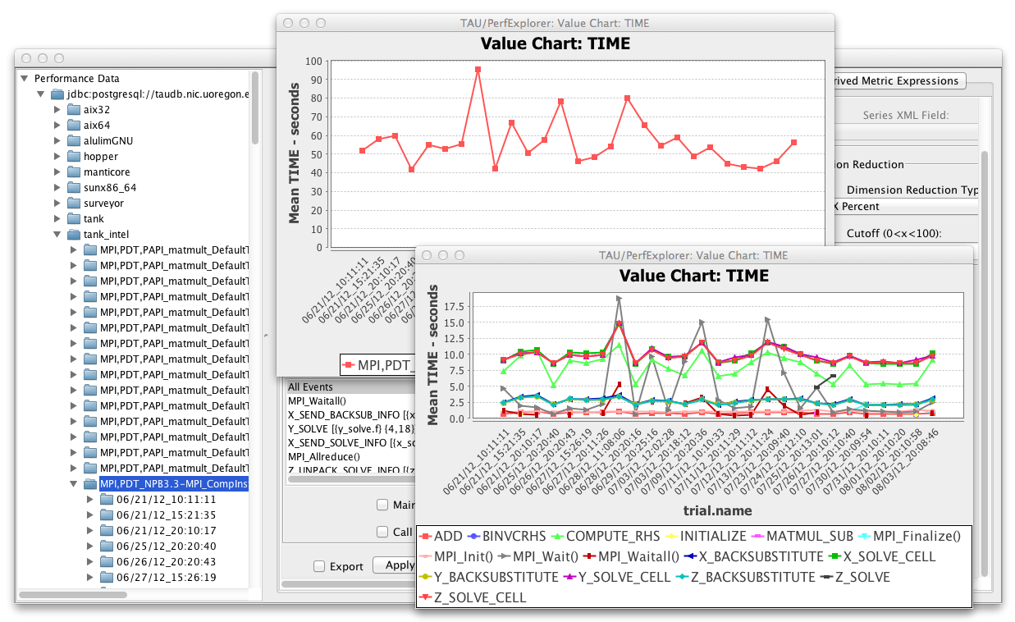
TAUdb Tool Support
ParaProf
Parallel profile analyzer
visual pprof
2, 3+D visualizations
Single and comparative experiment analysis
PerfExplorer
Data mining framework
Clustering, correlation
Multi-experiment analysis
Scripting engine
Expert system

Slide 27
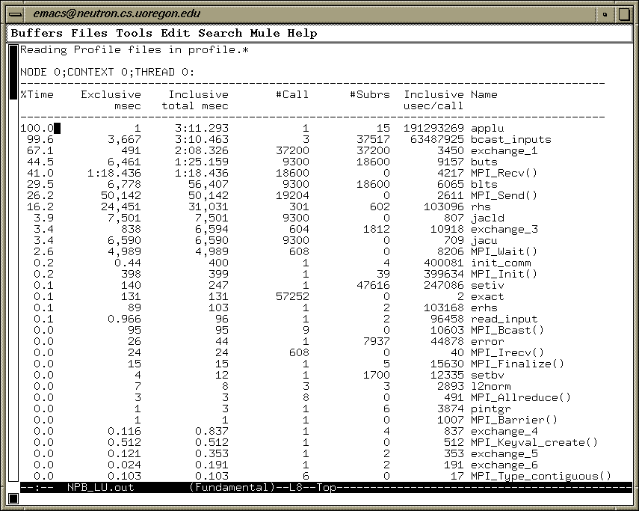
Parallel Profile Analysis – pprof

Slide 28
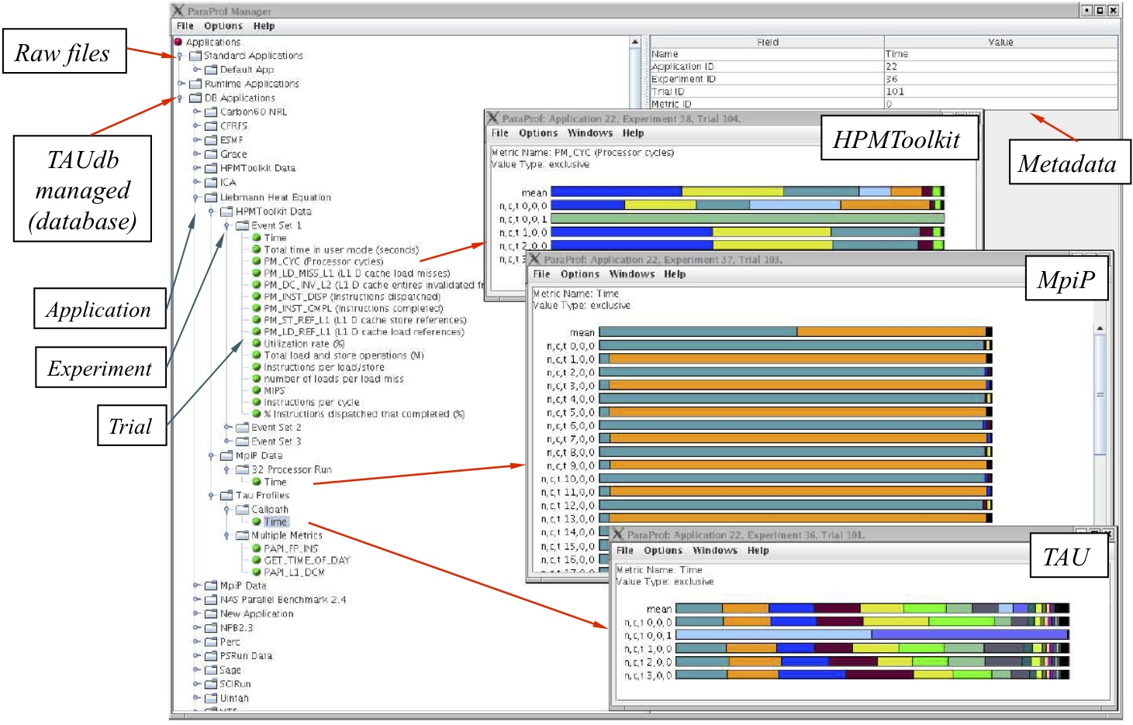
Parallel Profile Analysis – ParaProf

Slide 29
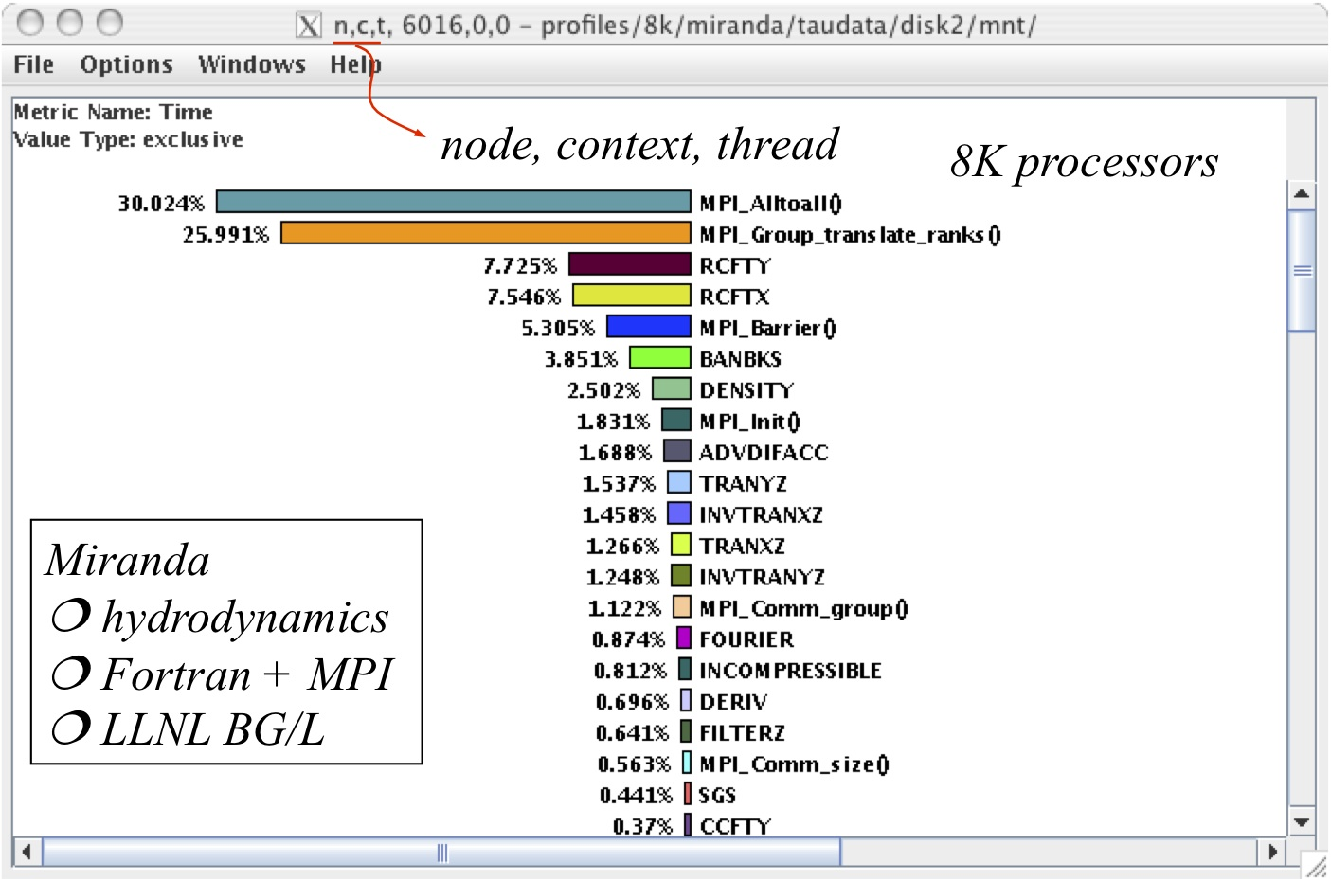
ParaProf – Single Thread of Execution View

Slide 30
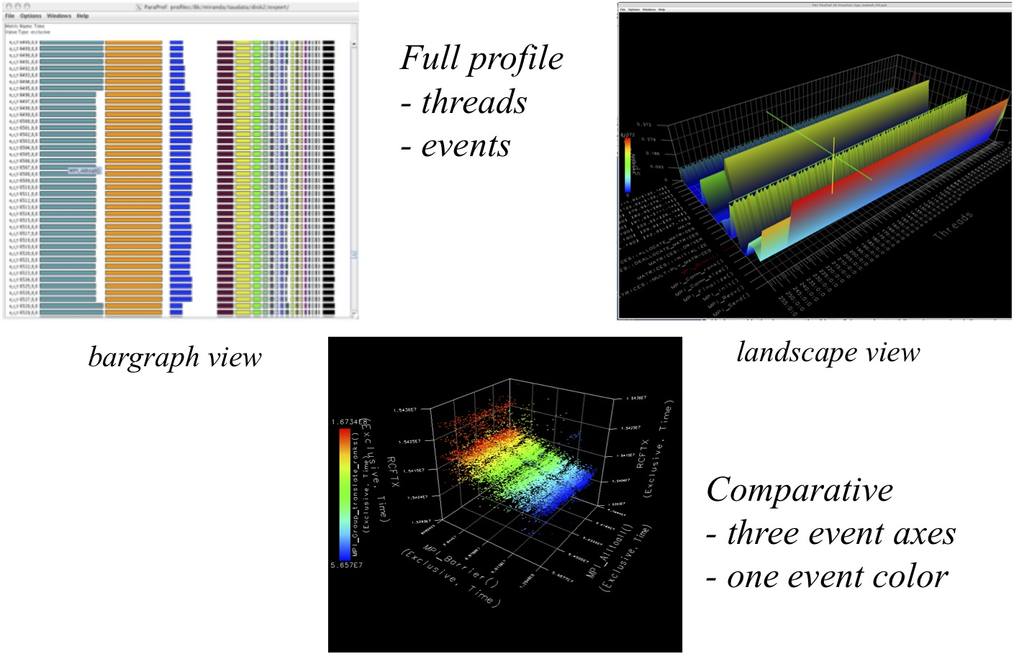
ParaProf – Full Profile / Comparative Views

Slide 31
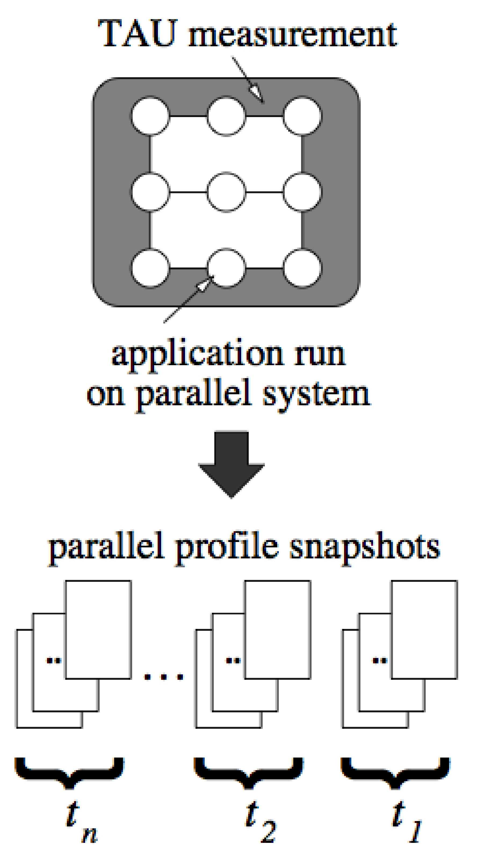
Performance Dynamics: Parallel Profile Snapshots
Profile snapshots are parallel profiles recorded at runtime
Shows performance profile dynamics (all types allowed)
Traces
Overhead
Profiles
Profile Snapshots
Information
A. Morris, W. Spear, A. Malony, and S. Shende, “Observing Performance Dynamics using Parallel Profile Snapshots,” European Conference on Parallel Processing (EuroPar), 2008.
Notes:
This slide shows a four processor Flash run showing how different snapshots differ. Before the main loop beings, I write a snapshot to mark the performance data up to that point. It shows up as “Initialization”. At the end of each loop, a snapshot is written. At the end of execution, a final snapshot is written labeled “Finalization”.
I’m 99% sure the four main spikes are the checkpointing phases involving a lot of IO. The big purple color on top is “Other”. I have it limited to top 20 functions + “other”.
31

Slide 32
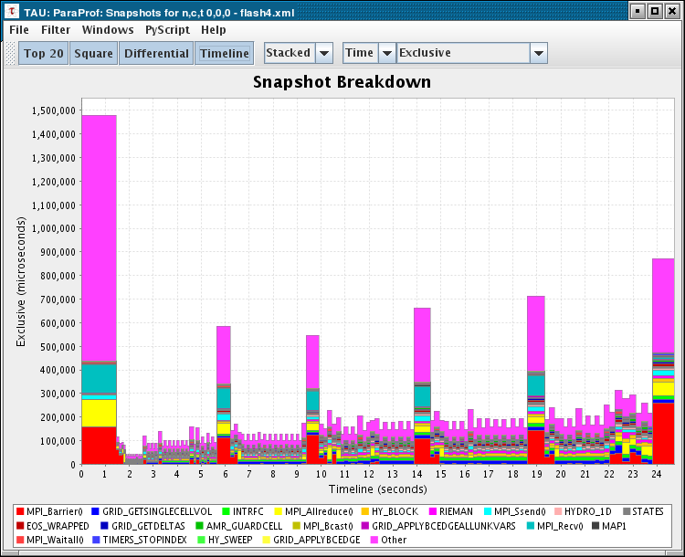
Parallel Profile Snapshots of FLASH 3.0
Simulation of astrophysical thermonuclear flashes
Snapshots show profile differences since last snapshot
Captures all events since beginning per thread
Mean profile calculated post- mortem
Highlight change in performance per iteration and at checkpointing
Initialization
Finalization
Checkpointing
Notes:
This slide shows a four processor Flash run showing how different snapshots differ. Before the main loop beings, I write a snapshot to mark the performance data up to that point. It shows up as “Initialization”. At the end of each loop, a snapshot is written. At the end of execution, a final snapshot is written labeled “Finalization”.
I’m 99% sure the four main spikes are the checkpointing phases involving a lot of IO. The big purple color on top is “Other”. I have it limited to top 20 functions + “other”.
32

Slide 33
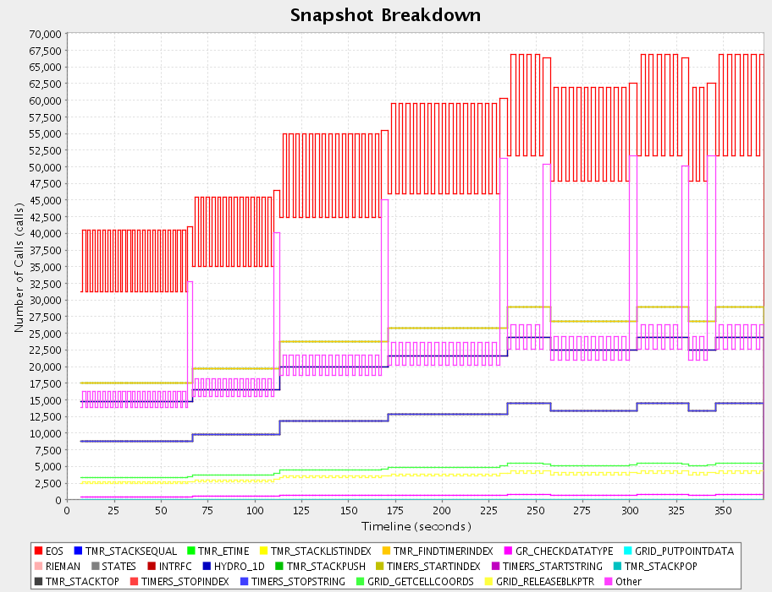
FLASH 3.0 Performance Dynamics (Periodic)
INTRFC
Notes:
Differential number of calls, line chart
33

Slide 34
How to explain performance?
Should not just redescribe the performance results
Should explain performance phenomena
What are the causes for performance observed?
What are the factors and how do they interrelate?
Performance analytics, forensics, and decision support
Need to add knowledge to do more intelligent things
Automated analysis needs good informed feedback
Performance model generation requires interpretation
Build these capabilities into performance tools
Support broader experimentation methods and refinement
Access and correlate data from several sources
Automate performance data analysis / mining / learning
Include predictive features and experiment refinement
Notes:
Check Dresden talk for common language for these slides

Slide 35

Role of Knowledge and Context in Analysis
Context Metadata
You have to capture these...
Source
Code
Build Environment
Run Environment
Performance Problems
Execution
Application
Machine
Performance Knowledge
...to understand this
Performance Result

Slide 36
Performance Data Mining / Analytics
Conduct systematic and scalable analysis process
Multi-experiment performance analysis
Support automation, collaboration, and reuse
Performance knowledge discovery framework
Data mining analysis applied to parallel performance data
parametric, comparative, clustering, correlation, …
Integrate available statistics and data mining packages
Weka, R, Matlab / Octave
Apply data mining operations in interactive enviroment
Meta-analysis based on metadata collection in TAU
hardware/system, application, user, …

Slide 37
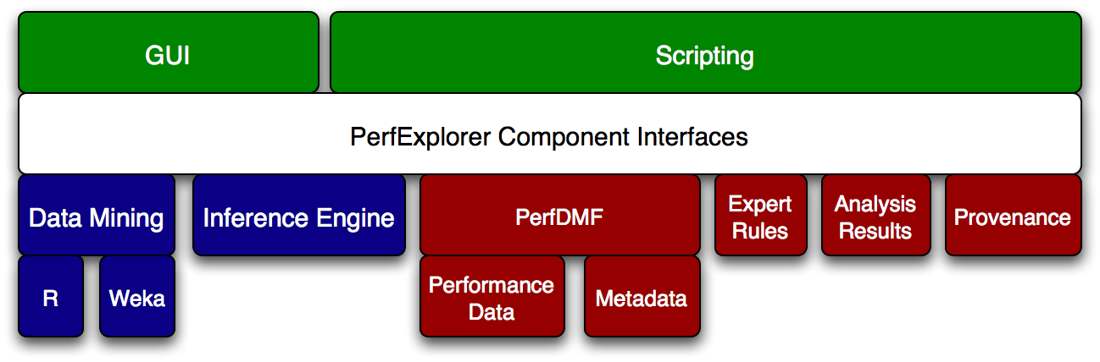
PerfExplorer Performance Data Mining
Programmable,extensible framework to support workflow automation
Rule-based inference for expert system analysis
Notes:
Get rid of text, get rid of last bullet, put next figure on this slide

Slide 38
Metadata Collection
Integration of XML metadata with parallel profile
Three ways to incorporate metadata
Measured hardware/system information
CPU speed, memory in GB, MPI node IDs, …
Application instrumentation (application-specific)
TAU_METADATA() used to insert any name/value pair
Application parameters, input data, domain decomposition
TAUdb can load an XML file of additional metadata
Compiler flags, submission scripts, input files, …
Metadata can be imported from several sources

Slide 39
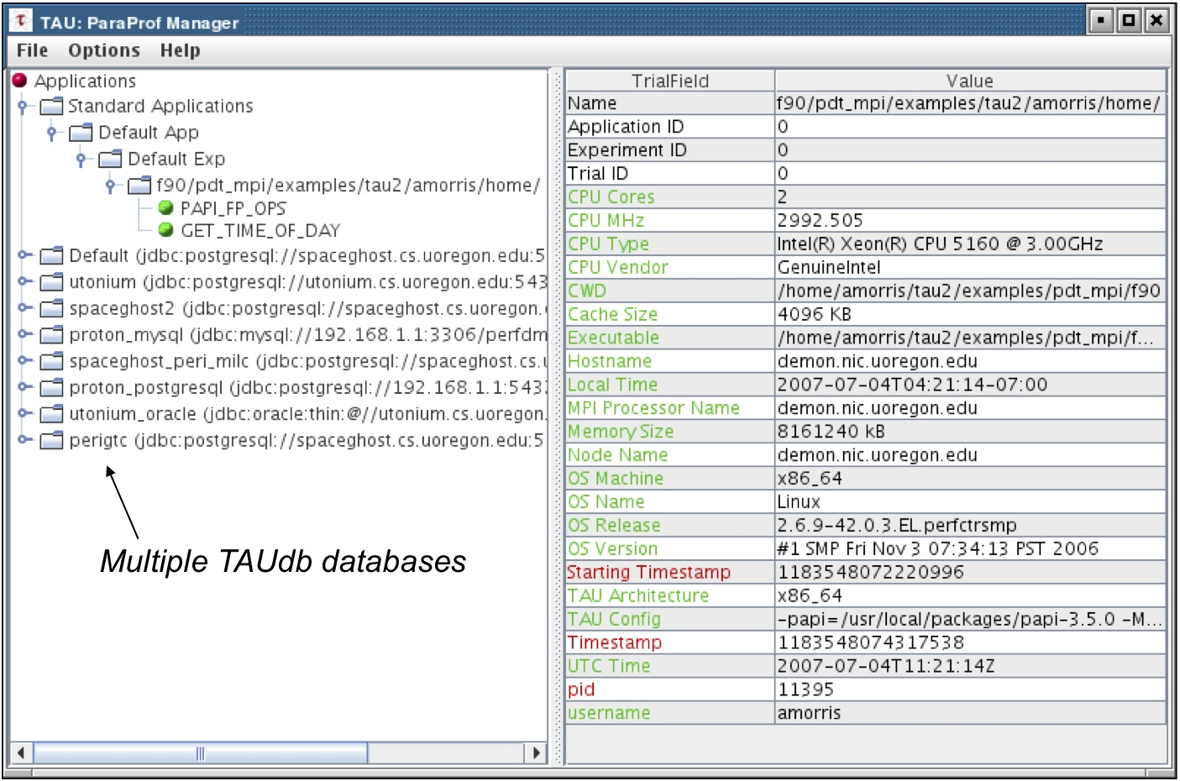
Performance Experiment Metadata

Slide 40
TAU Availability on New Systems
Intel compilers with Intel MPI on Intel Xeon PhiTM (MIC)
GPI with Intel Linux x86_64 InfiniBand clusters
IBM BG/Q and Power 7 Linux with IBM XL compilers
NVIDIA Kepler K20 with CUDA 5.5 with NVCC
Fujitsu Fortran/C/C++ MPI compilers on the K computer
PGI compilers with OpenACC support on NVIDIA systsems
Cray CX30 Sandybridge Linux systems with Intel compilers
AMD OpenCL libs with GNU on AMD Fusion cluster
MPC compilers on TGCC Curie system (Bull, Linux x86_64)
GNU on ARM Linux clusters (MontBlanc, Beacon, Stampede)
Cray CCE compilers with OpenACC on Cray XK6, XK7
Microsoft MPI w/ Mingw compilers on Windows Azure
LLVM and GNU compilers under Mac OS X, IBM BG/Q

Slide 41
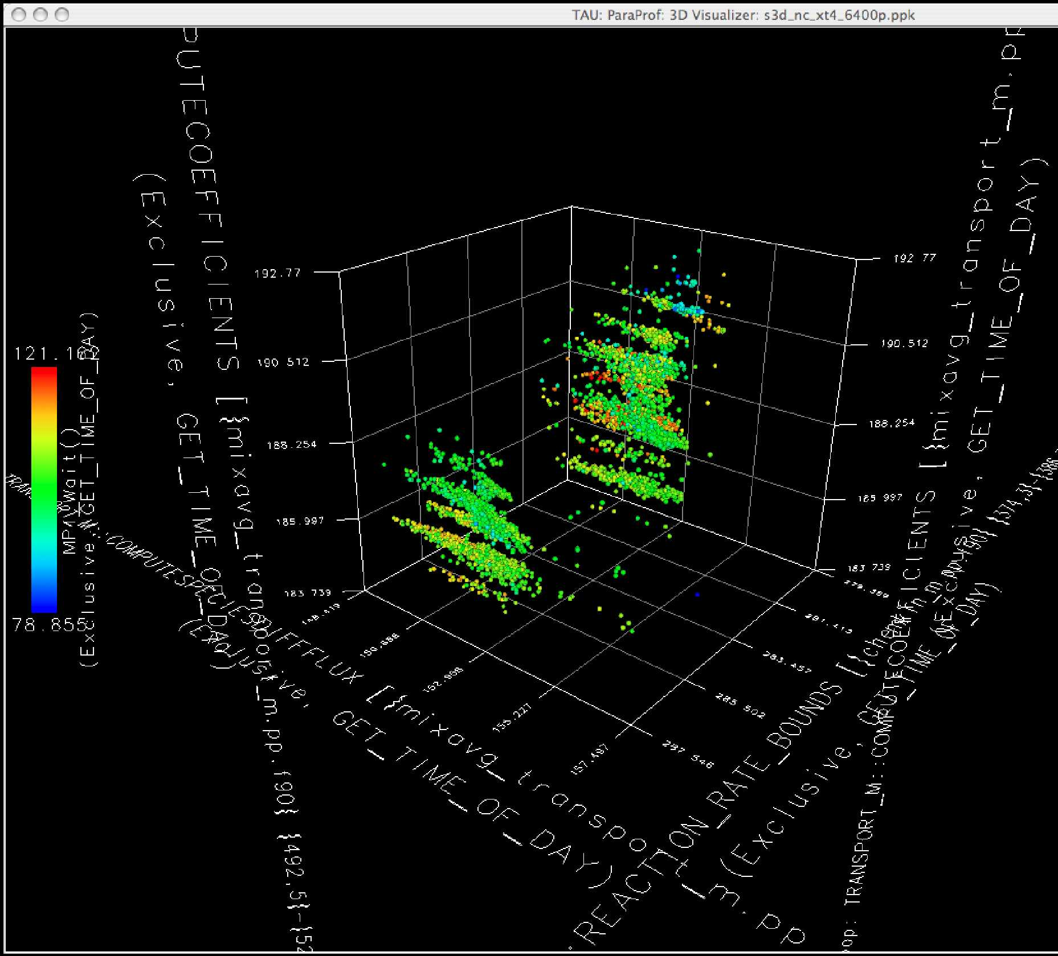
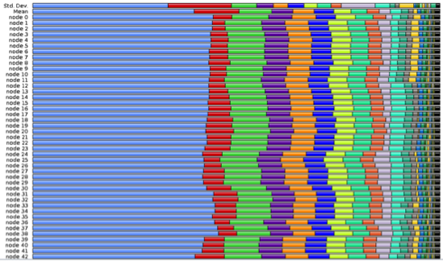
Performance Visualization
Large performance data presents interpretation challenges
Visualization aids in data exploration and pattern analysis
3D visualization can help in identifying relations between events/metrics
Existing tools provide “canned” views
TAU provides a few 2D: bargraph, histogram 3D: full profile, correlation
Developing new visualizations is a challenge
Strategy 1: Create new view for each problem
Strategy 2: Use external visualization environment
Provide high-level support to use within existing framework

Slide 42
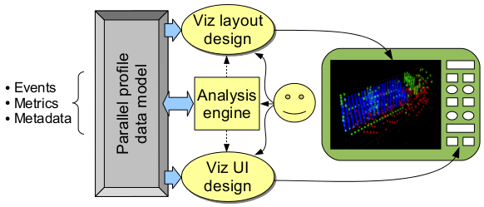
Extending Visualization Support in Profile Tool
User defines visualization
Based on performance data model
Specifies layout based on events, metrics, and metadata
UI provides control of data binding and visualization

Slide 43
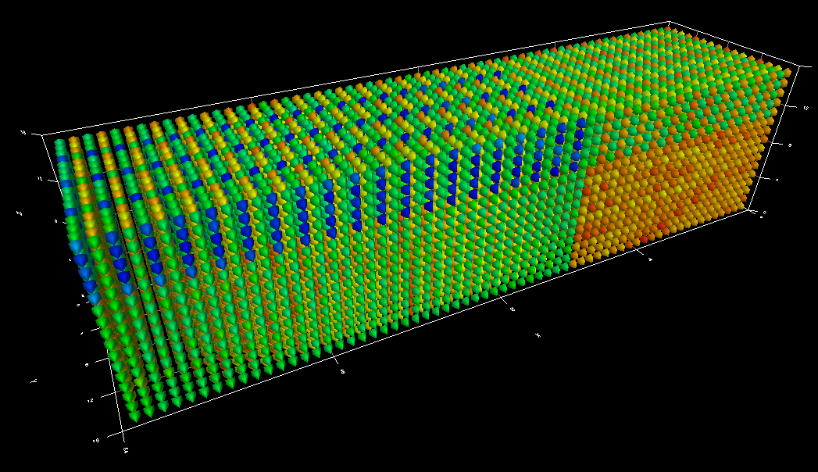
Using Process Topology Metadata
Inspired by the Scalasca CUBE topology display
Each point represents a thread of execution (MPI process)
Positioned according to the Cartesian (x,y,z,t) coordinates
Color is determined by selected event/metric value
Topology information can be recorded in TAU metadata
ParaProf reads metadata to determine topology and create layout
Sweep3D is a 3D neutron transport application
16K run on BG/P
Color is exclusive time in the “sweep” function

Slide 44
Topology Control UI
Layout tab allows customization of the position and visibility of data points
Performance event/metric data used to define color and position is selected in the Event tab
Additional rendering options, such as color scale and point size are available
4k-core S3D run on BG/P
Select the plot type. The 'Topolgy' plot allows custom definition of performance data layouts
Hide points with values outside of the range
Move both range sliders at once
Show only points along the selected slice of an axis
The average value of visible points.
Select preset or custom layouts
Set X-, Y-, Z-axis dimensions

Slide 45
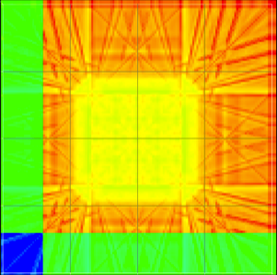

Alternate Topologies
Certain views may hide deeper inter-process behavior
Spatially dependent performance issues may be revealed by manipulating topology
Sweep3D profile with alternative Cartesian mapping exposes distribution of computational effort
Topology has direct effect on communication
Visualization mapped to hardware topologies can suggest better node/rank mapping
MPI_AllReduce() values for Sweep3D highlights waiting distribution from rank 0 (lower left) to the most distant rank (upper right)

Slide 46
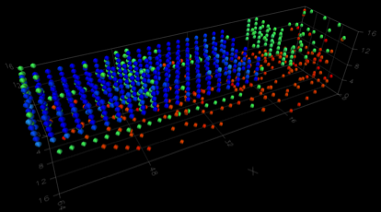
Viewing Internal Structure
Dense topologies can hide internal structure
Restrict visibility by color value to expose performance patterns
ParaProf visualization UI now allows for range filtering
Mid-level values can be excluded
Remaining points are:
high outliers (hotspots)
low outliers (underutilized nodes)

Slide 47
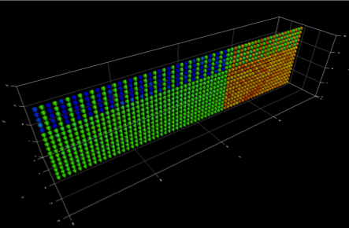
Slicing to Reduce Dimensionality
Restrict visibility to slices along the spatial axes
Multiple axis controls allow selection of planes, lines, or an individual point
ParaProf visualization UI provides filtering control
Averaging the color value for all points in the selected area

Slide 48
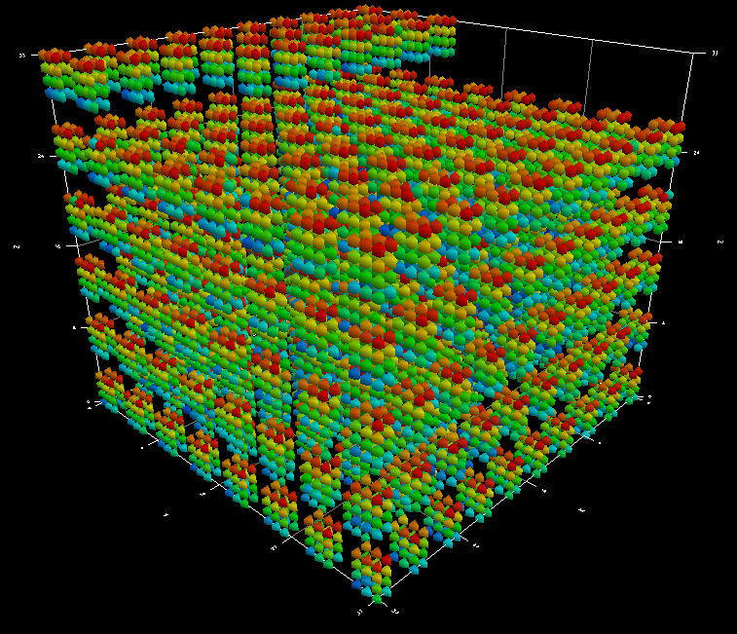
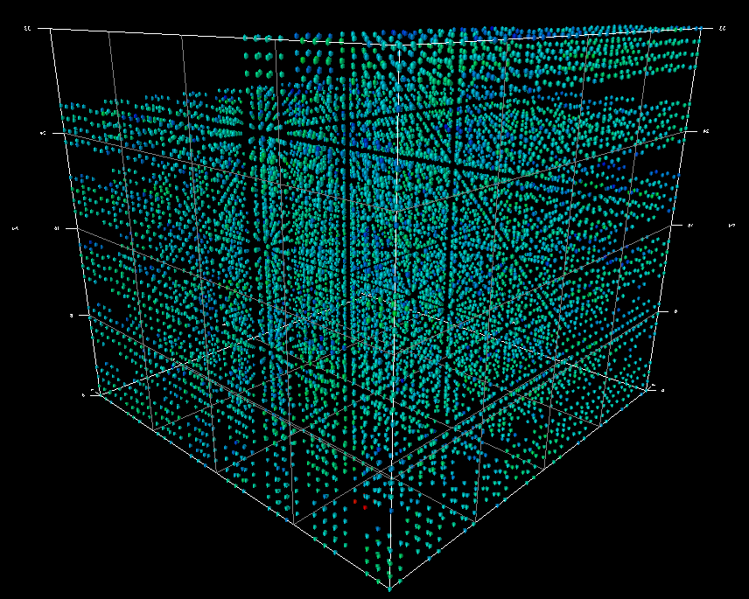
Cray XE6 Topology
Now have ability to capture Cray XE6 topology metadata
Node topology and core identity
GCRM is a global cloud resolving mode
Visualization of 10K execution
Topological layout attempts to capture node cores
12-core node
MPI_Init
MPI_Allreduce

Slide 49
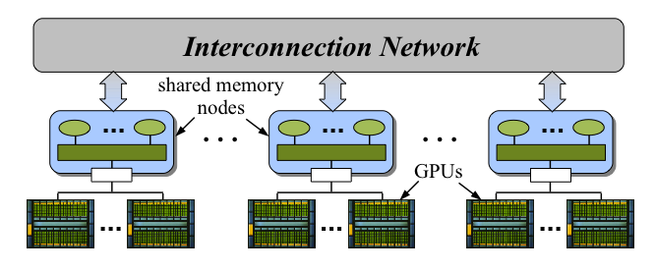
Heterogeneous Parallel Performance
Heterogeneous parallel systems are very relevant today
Multi-CPU, multicore shared memory nodes
Manycore (throughput) accelerators
Cluster interconnection network
Performance is the main driving concern
Heterogeneity is an important path to extreme scale
Heterogeneous software technology to get performance
More sophisticated parallel programming frameworks
Integrated parallel performance tools
support heterogeneous performance model and perspectives

Slide 50
Implications for Performance Tools
Current status quo is somewhat comfortable
Mostly homogeneous parallel systems and software
Shared-memory multithreading – OpenMP
Distributed-memory message passing – MPI
Parallel computational models are relatively stable
Corresponding performance models are tractable
Parallel performance tools can keep up and evolve
Heterogeneity creates richer computational potential
Greater performance diversity and complexity
Heterogeneous system environments
Performance tools have to support richer computation models and more versatile performance perspectives
Will utilize more sophisticated programming and runtime

Slide 51
Heterogeneous Performance Views
Want to create performance views that capture heterogeneous concurrency and execution behavior
Reflect interactions between components
Capture performance semantics of computation
Assimilate performance for all execution paths
Existing parallel performance tools are CPU (host)-centric
Event-based sampling
Direct measurement (instrumentation of events)
What perspective does the host have of other components?
Determines semantics of the measurement data
Determines assumptions about behavior and interactions
Performance views may have to work with reduced data

Slide 52
TAU for Heterogeneous Performance Analysis
Extend TAU for heterogeneous performance analysis
Integrate Host-GPU support in TAU measurement
Enable host-GPU measurement approach
target CUDA and NVIDIA GPUs
utilize CUPTI and PAPI CUDA
interface with compilers (PGI)
Provide both heterogeneous profiling and tracing
contextualization of asynchronous kernel invocation
Additional support
TAU wrapping of libraries (tau_gen_wrapper)
Work with library preloading (tau_exec)
A. Malony, et al., “Parallel Performance Measurement of Heterogeneous Parallel Systems with GPUs,” International Conference on Parallel Processing (ICPP 2011), Taipei, Taiwan, 2011.

Slide 53
How TAU GPU Support Works
Approach 1: CUDA library wrapping + CUDA events
CUDA driver or runtime API are intercepted
Approach 2: CUDA Profiling Tools Interface (CUPTI)
Callback API – a callback is registered for every API call
Counter API -- GPU device counters (device-level)
Activity API – kernel and memory copy timing information
With both of these methods, TAU records the activity that occurred on the GPU at a synchronization point
Performance data is merged with TAU profile/trace
Divided between CPU and GPU
Each GPU stream/context presented as a separate thread

Slide 54
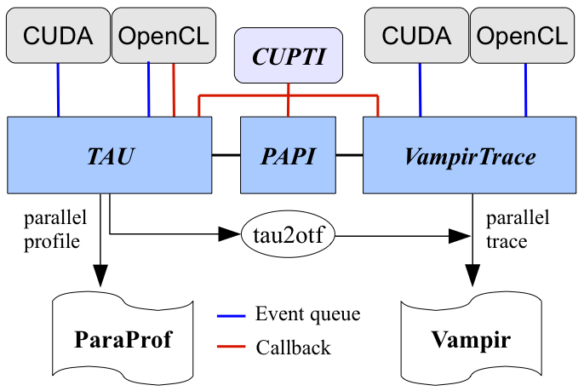
GPU Performance Tool Interoperability

Slide 55
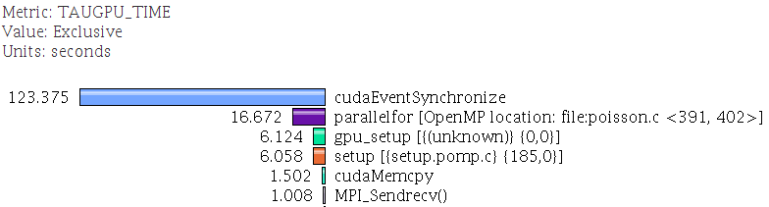
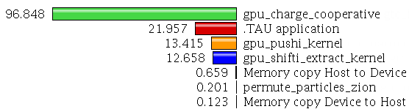
A TAU Profile with GPU Performance Data
CPU events:
GPU synchronization
OpenMP region
Memory copy on CPU
CPU-GPU communication events (recorded on CPU):
MPI communication
Bytes transferred
GPU events:
GPU kernels
Memory copy time
on GPU

Slide 56
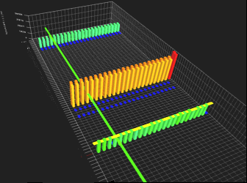
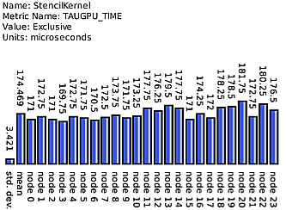
SHOC Stencil2D Parallel Profile
3 GPUs
24 GPUs

Slide 57
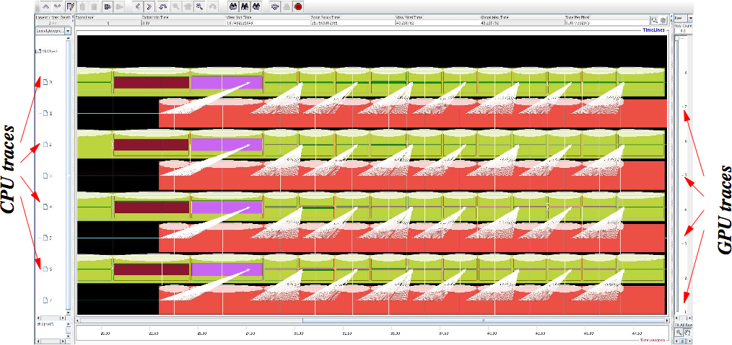
SHOC Stencil2D Trace (4 CPUxGPU)
Visualization using Jumpshot (Argonne)
CUDA memory transfer (white)

Slide 58
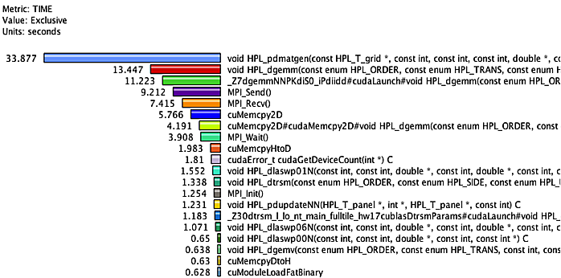
CUDA Linpack Profile (4 CPUxGPU)
GPU-accelerated Linpack benchmark (NVIDIA)

Slide 59
CUDA Linpack Trace
CUDA memory transfer (white)
MPI communication (yellow)

Slide 60
SHOC FFT Profile with Callsite Info
Callsite information breaks up kernel execution time by where in the application the kernel was launched.
Callsite information links the kernels on the GPU with functions that launch them on the CPU.
Callsite paths can be thought of as an extension of a callpath spanning both CPU and GPU.
Three kernels: ifft1D_512, fft1D_512, chk1D_512
Callsite shows single or double precession step

Slide 61
TAU and OpenACC
CUPTI works with OpenACC applications
However the operations the compiler (PGI, Cray)does to generate code is hidden
We can retrieve this information by integrating into the compiler directly
Working with the PGI compiler to discover which OpenACC regions are responsible for which GPU events

Slide 62
PGI Compiler ACC integration
Memory copies recorded by CUPTI are anonymous
Collect information from the PGI compiler
Notes:
With CUPTI we see three different kinds memory copies being made. By instrumenting the PGI compiler we can see that there were five total copies, three to copy matrices A,B (to device), C (back to Host) as well as two for this temporary variable b1 (both to device and back to the host).

Slide 63
CUDA Kernel Tracking
Track register usage for each kernel
Local, shared and device registers
Familiar technique of sharing blocks of memory on the GPU is capture by this feature
GPU occupancy is calculated for each kernel automatically

Slide 64
Compare Two Matrix Multiply Cases
Simple
No use of shared memory
Improved
Utilize the shared memory
Better use of registers
multiply_matrices(float *d_a, float *d_b, float *d_c, int lda)
...
for (unsigned int j=0; j<M; j++) {
ctemp = ctemp + d_a[idx(row,j,lda)] * d_b[idx(j,col,lda)];
}
d_c[id] = ctemp;
...
multiply_matrices_shared_blocks(float *d_a, float *d_b, float *d_c, int lda)
...
for (int k = 0; k < (M / bs); k++) {
//form submatrices
a[sub_row][sub_col] = sub_a[idx(sub_row, sub_col, lda)];
b[sub_row][sub_col] = sub_b[idx(sub_row, sub_col, lda)];
//wait for all threads to complete copy to shared memory.
__syncthreads();
//multiply each submatrix
for (int j=0; j < bs; j++) {
c = c + a[sub_row][j] * b[j][sub_col];
}
// move results to device memory.
d_c[id] = c;
// wait for multiplication to finish before moving onto the next submatrix
__syncthreads();
…

Slide 65
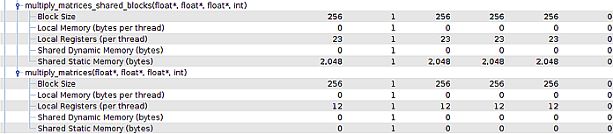
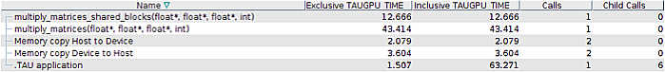
CUDA Device Memory Profile
Use of shared memory
Increase in register usage
Improved
Simple
2.4x speedup by using shared memory

Slide 66
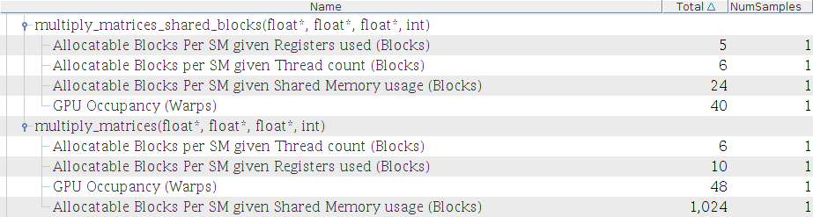
CUDA Kernel Occupancy
Block per SM limited by the
number of registers used
83% of 48 total wraps occupied

Slide 67
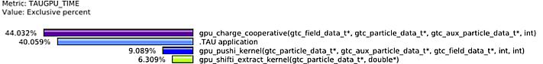
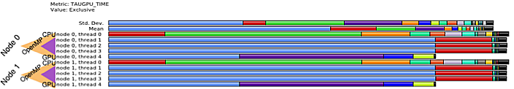
Heterogeneous Performance Case Study
Gyrokinetic Toroidal Simulations (GTC)
Fusion simulation
GTC CUDA version has been developed
OpenMP + CUDA
Three CUDA kernels

Slide 68
GTC Performance Trace
GPU threads and OpenMP threads are integrated into trace

Slide 69
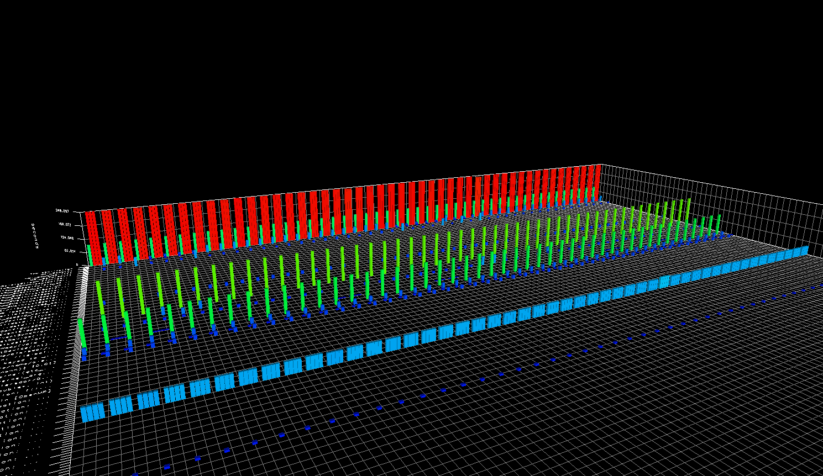
GTC on NSF Keeneland
HP SL390 GPU cluster
2 Intel Xeon CPUs, 3 NVIDIA GPUs (M2070/M2090)
GTC run on 16 nodes
48 MPI ranks, 198 OpenMP threads, 48 GPUs
Thread Idle
OpenMP Loop
CPU Waiting
Chargei Kernel

Slide 70







Common Infrastructure Integration – Score-P
Community effort for a common tools infrastructure
Starting with TAU, Periscope, Scalasca, and Vampir
Open for other tools and groups
Joint development of Score-P
Core performance measurement infrastructure
MPI, OpenMP, heterogeneous
DOE-funded PRIMA project
University of Oregon
Forschungszentrum Jülich
BMBF-funded SILC project (multiple partners)

Slide 71
Score-P Architecture
TAU
Vampir
Scalasca
TAU
Periscope
Score-P measurement infrastructure
Event traces (OTF2)
Call-path profiles (CUBE4)
Online interface
supplemental instrumentation + measurement support
Hardware counter (PAPI)
TAU adaptor
Application (MPI, OpenMP, hybrid)
Instrumentation
MPI wrapper
Compiler
TAU instrumentor
OPARI 2
COBI

Slide 72
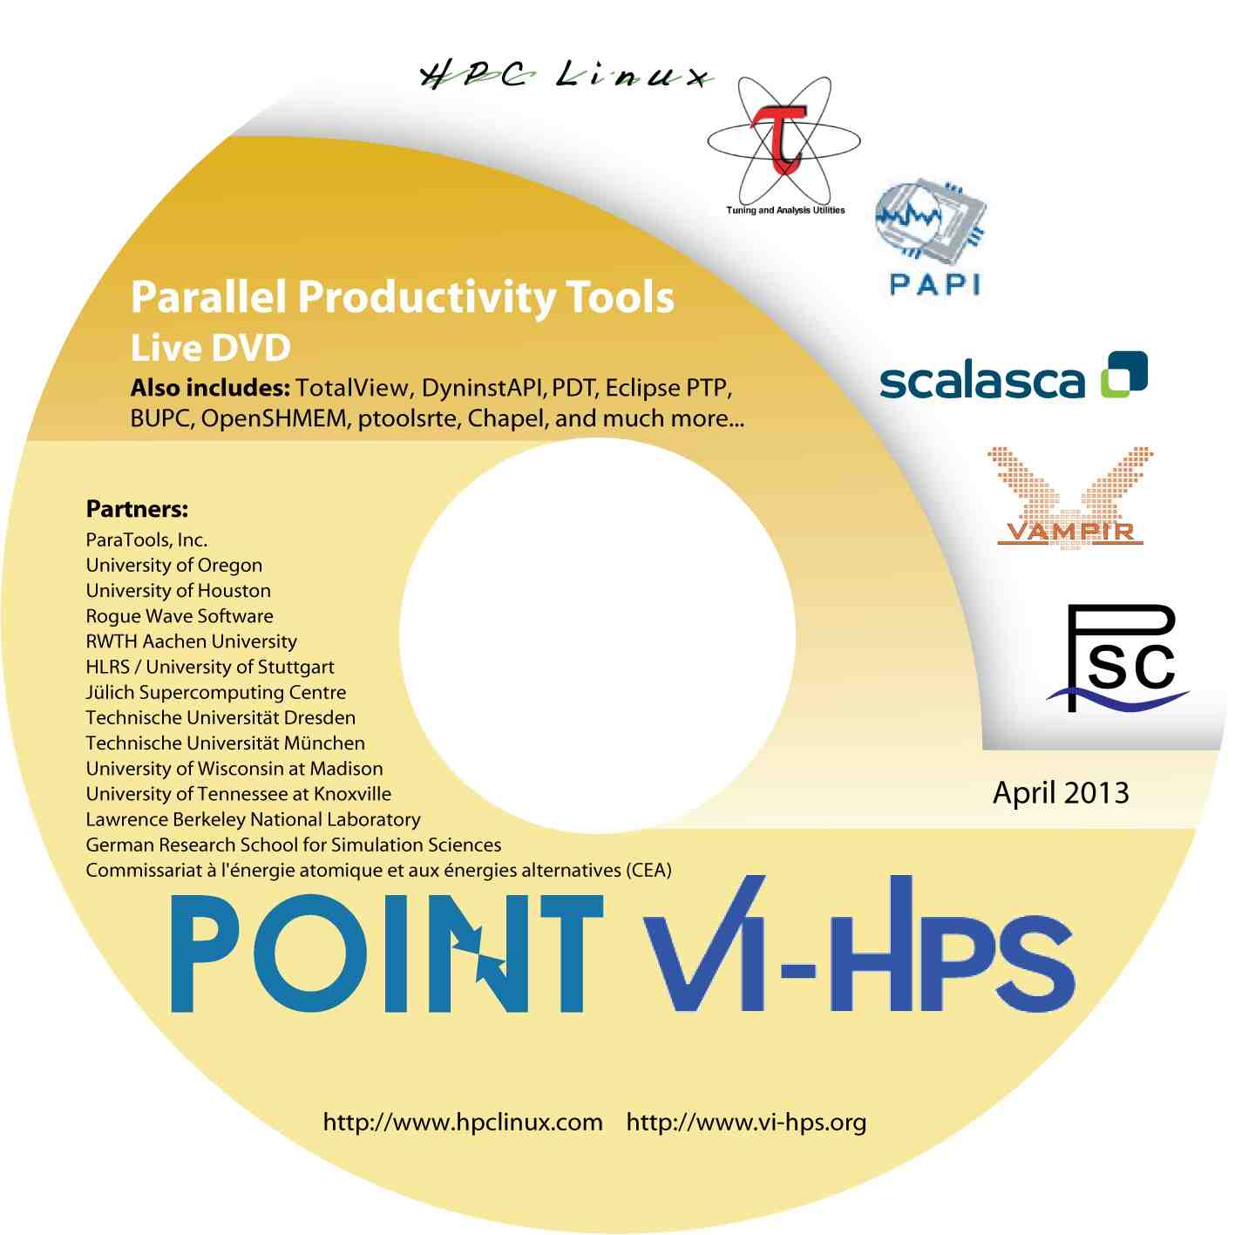
For More Information …
TAU Website http://tau.uoregon.edu
Software
Release notes
Documentation
HPC Linux http://www.hpclinux.com
Parallel Tools “LiveDVD”
Boot up on your laptop or desktop
Includes TAU and variety of other packages
Include documentation and tutorial slides
New image just released at SC’13!

Slide 73
Short Course Outline
Lecture 1: Introduction and Fundamentals
Lecture 2: Methodology
Lecture 3: Tools Technology
Lecture 4: Tools Landscape – Part 1
Lecture 5: Tools Landscape – Part 2
Lecture 6: TAU Performance System
Lecture 7: TAU Applications
Lecture 8: Advances in TAU
Lecture 9: Future Directions
Tuesday
Wednesday
Thursday

